Slide 1
No-SQL Databases
NoSQL refers to Not Only SQL databases
Next Generation Databases mostly addressing business problems; some of the points: being non-relational, distributed, open-source and horizontally scalable.
The movement began early 2009 and is growing rapidly.
Main Characteristics:
Schema free
Easy replication support
Simple API
Eventually Consistent( Referred as BASE – Basically Available Eventually Consistent properties)
Huge Amount data

Slide 2
No-SQL Databases Types
Graph Database
A database, which uses graph structures for semantic queries with nodes, edges, Neo4j is one graphDB.
Key-Value Database
A key value store, is a simple DB where each key is associated with one and only one value in collection. Cassandra, Oracle BerkleyDB, Amazon DynamoDB is popular DB here.
Column Database
Column oriented databases store tables in columnar format, rather than rows.
Column oriented databases are faster in access compared to row oriented like RDBMS, as data retrieval becomes easy when stored as separate columns. E.g. Hbase, Google BigTable, Cassandra
Cassandra is more like a hybrid database of Key-value and columnar database.
Document Database
A document-oriented database such as MongoDB use JSON format in order to store data.
MongoDB, Written in c++, is a cross-platform, document oriented database that provides, high performance, high availability, and easy scalability.
Schema less − MongoDB is a document database in which one collection holds different documents. Scalability − MongoDB is easy to scale horizontally.
Embedded documents and arrays reduce need for expensive joins.
Consistency – In mongodb, data is eventual consistent, meaning data will be written to secondary.

Slide 3
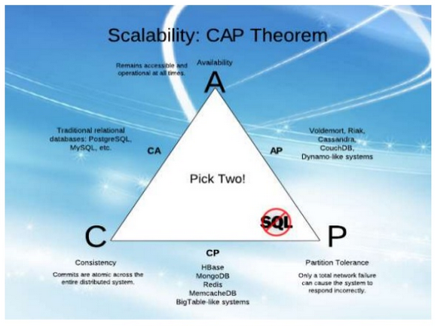
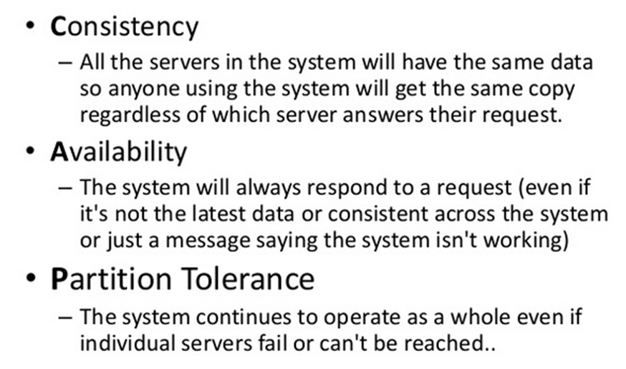
CAP Theorem

Slide 4
HBase
HBase is the Hadoop database modeled after Google's Bigtable.
HBase native API is written in Java, but you do not have to use Java to access its API.
Hbase supports easy scaling, sharding and flexible schema model for sparse records.
HBase supports random read/write access to the Big Data and data is stored in byte only.
Fault tolerance is handled by replication and no need to worry about individual node down.
Columns are grouped into Column Families which must be defined up front.
HBase tables consists of rows and Each row must have a unique rowkey and index is created only on rowkey column.
Columns can have multiple timestamps to indicate the version and the most recent version of the data is shown first.

Slide 5
Why HBase
Apache Hadoop includes HBase
Allows HBase to leverage the Map/Reduce model
HBase can replace costly implementation of RDBMS for Big Data applications
HBase is not a one size fit all approach. It is designed for big data applications with specific data access patterns in mind.
Not meant to replace RDBMS entirely!
HBase enables horizontal scalability for very large data sets
Easily scalable by adding additional commodity hardware without interruption.
HBase supports flexible data models of sparse records
We do not need to know the data types in advance. Keeps our schema very flexible.
HBase supports random read/write access to the Big Data
Very quick and efficient, random reads and writes
Sharding is automatic without consequences from the RDBMS approach
Built-in feature to HBase that can be customized

Slide 6
HBase vs RDBMS
 | HBase | RDBMS
Hardware Architecture | Similar to Hadoop. Clustered commodity hardware. Very affordable. | Typically large scalable multiprocessor systems. Very expensive.
Fault Tolerance | Built into the architecture. Lots of nodes means each is relatively insignificant. No need to worry about individual node downtime. | Requires configuration of the HW and RDBMS with the appropriate high availiable options
Typical Database Size | Terabytes to Petabytes – hundred of millions to billions of rows. | Gigabytes to Terabytes – hundred to thousands to millions of rows.
Data Layout | A sparse, distributed, persistent, multidimensional sorted map. | Rows or column oriented.
Data Types | Bytes only. | Rich data type support.
Transactions | ACID support on a single row only | Full ACID compliance across rows and labels
Query Language | API primitive commands only, unless combined with Hive or other technology | SQL
Indexes | Row-Key only unless combined with other technologies such as Hive or IBM’s BigSQL | Yes
Throughput | Millions of queries per second | Thousands of queries per second

Slide 7
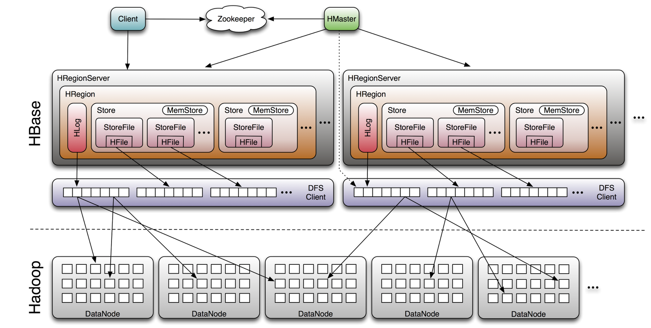
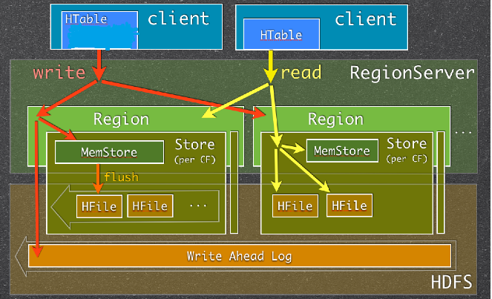
Hbase Architecture

Slide 8
Components
Hbase Master
Checks status and load rebalancing of region servers , assigns regions to region Servers. Multiple Masters (One Active) are allowed for high availability with Zookeeper.
Hbase RegionServer
The HBase Contains one or more Regions, Hosts the tables, perform read/write, buffers. Client talks directly to the Region Server for their data.
Regions
The rows of a table are stored within Region, A table's data is automatically sharded across multiple regions when the data gets too large and Each region stores a single Column Family.
Each row key belongs to a specific region which is served by a region server. So based on the put or delete’s key, an HBase client can locate a proper region server. At first, it locates the address of the region server hosting the -ROOT- region from the Zookeeper quorum. From the root region server, the client finds out the location of the region server hosting the -META- region. From the meta region server, then we finally locate the actual region server which serves the requested region. This is a three-step process, so the region location is cached to avoid this expensive series of operations.

Slide 9
Components
Zookeeper
For any distributed application, Zookeeper is a critical component . For Hbase it ensures one active Master is running for fault tolerance on Hbase.
Block cache
As HBase reads entire blocks of data for efficient I/O usage, it retains these blocks in an in-memory cache so that subsequent reads do not need any disk operation. The default of true enables the block cache for every read operation.
Block size
All stored files in HBase are divided into smaller blocks that are loaded during any get or scan operation. The default is set to 64KB.
Store
A Store hosts a MemStore and 0 or more StoreFiles (HFiles).
A Store corresponds to a column family for a table for a given region.
MemStore
Each change is stored in a place in memory called the MemStore, which efficiently supports random writes. Data in the MemStore is sorted in the same manner as data in a Hfile.

Slide 10
Components
StoreFiles (HFile)
StoreFiles are where your data lives.
HBase has pluggable compression algorithm support that allows you to choose the best compression or none for the data stored in a particular column family. Supported compression algorithms as None, GZ, LZO or SNAPPY.
There are two types of compactions happens while storing HFiles.
Minor compactions will usually pick up a couple of the smaller adjacent StoreFiles and rewrite them as one. Minors do not drop deletes or expired cells, only major compactions do this.
Major compactions will usually have to be done manually on large systems, After a major compaction runs there will be a single StoreFile per Store, and this will help performance.
Hlog/WAL
where all logs are written about each record.

Slide 11
Data Model
Table
An HBase table consists of multiple rows.
Row
A row in HBase consists of a row key and one or more columns with values associated with them. Rows are sorted alphabetically by the row key as they are stored.
Column
A column in HBase consists of a column family and a column qualifier, which are delimited by a : (colon) character.
Column Family
Column families physically colocate a set of columns and their values, often for performance reasons.
Column Qualifier
A column qualifier is added to a column family to provide the index for a given piece of data. Column families are fixed at table creation, column qualifiers are mutable and may differ greatly between rows.
Cell
A cell is a combination of row, column family, and column qualifier, and contains a value and a timestamp.
Timestamp
A timestamp is written alongside each value, and is the identifier for a given version of a value.

Slide 12
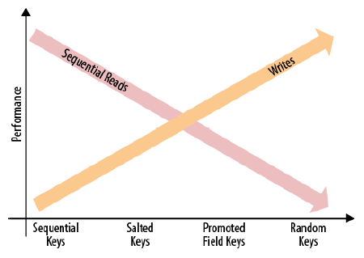
Row key design considerations
Having an efficient HBase system is highly dependent on how you choose your row key, or primary key(for those still in the RDBMS mindset)
Choose keys that can allow your data to be distributed as evenly as you can for your usage
Hot spotting occurs when a large amount of client traffic is directed at one node, or only a few nodes, of a cluster.

Slide 13
Hbase Shell Commands
hbase> status 'summary'
hbase> version
hbase> whoami
hbase> list
Create table Command //create a table in database
create 'Retail', {NAME=>'CustInfo'}, {NAME=>'BrandsPurchased'}
Put //add a record in a table
Row1:
put 'Retail', '1042', 'CustInfo:name', 'cust1'
put 'Retail', '1042', 'CustInfo:age', 43
put 'Retail', '1042', 'BrandsPurchased:brand1', 43
put 'Retail', '1042', 'BrandsPurchased:brand2', 78
put 'Retail', '1042', 'BrandsPurchased:brand3', 29
put 'Retail', '1042', 'BrandsPurchased:brand4', 54

Slide 14
Hbase Shell Commands
Row2:
put 'Retail', '1041', 'CustInfo:name', 'cust2'
put 'Retail', '1041', 'CustInfo:age', 41
put 'Retail', '1041', 'BrandsPurchased:brand1', 24
put 'Retail', '1041', 'BrandsPurchased:brand3', 73
Row3:
put 'Retail', '1043', 'CustInfo:name', 'cust3'
put 'Retail', '1043', 'CustInfo:age', 27
put 'Retail', '1043', 'BrandsPurchased:brand1', 53
put 'Retail', '1043', 'BrandsPurchased:brand5', 21
put 'Retail', '1043', 'BrandsPurchased:brand3', 56
put 'Retail', '1043', 'BrandsPurchased:brand7', 32

Slide 15
Hbase Shell Commands
Row4:
put 'Retail', '1044', 'CustInfo:name', 'cust4'
put 'Retail', '1044', 'CustInfo:age', 53
put 'Retail', '1044', 'BrandsPurchased:brand2', 98
put 'Retail', '1044', 'BrandsPurchased:brand3', 15
Row5:
put 'Retail', '1045', 'CustInfo:name', 'cust5'
put 'Retail', '1045', 'CustInfo:age', 19
put 'Retail', '1045', 'BrandsPurchased:brand1', 98
put 'Retail', '1045', 'BrandsPurchased:brand2', 44
put 'Retail', '1045', 'BrandsPurchased:brand3', 12

Slide 16
Hbase Shell Commands
count 'Retail' //Number of records:
SCAN Command //retrieve a set of records from a table
scan 'Retail'
scan 'Retail',{STARTROW=>'1043'}
scan 'Retail',{STOPROW=>'1043'}
scan 'Retail', {STARTROW=> '1042', STOPROW=> '1044'}
scan 'Retail',{COLUMNS=>'CustInfo:name',STARTROW=>'1042',STOPROW=>'1044'}
Get Command //retrieve a record from a table
get 'Retail','1045'
get 'Retail', '1045', COLUMN=>['BrandsPurchased:brand3', 'BrandsPurchased:brand2', 'BrandsPurchased:brand1']
get 'Retail', '1045', {COLUMN => ['BrandsPurchased:brand3'],VERSIONS => 1}

Slide 17
Hbase Shell Commands
Alter Command //Alter a table (add or delete column family)
alter 'Retail', {NAME => 'dept', VERSIONS => 5} //add column family with 5 cell VERSIONS
hbase> alter 't1', {NAME => 'f1', METHOD => 'delete'} or
hbase> alter 't1', 'delete' => 'f1' // To delete the 'f1' column family in table 't1',
update records
get 'Retail', '1045',COLUMN=>['BrandsPurchased:brand3']
put 'Retail', '1045', 'BrandsPurchased:brand3', 15
get 'Retail', '1045',COLUMN=>['BrandsPurchased:brand3']
delete/deleteall Command //delete a entire row or a column, or a cell from a table
delete 'Retail', '1045','BrandsPurchased:brand3'
deleteall 'Retail', '1045'

Slide 18
Hbase Shell Commands
truncate :Disables, drops and recreates the specified table.
truncate 'Retail'
Disable and enable Commands //Disable/enable the named table
disable 'Retail'
is_disabled 'Retail' //Verifies Is named table disabled
Drop the named table. Table must first be disabled
drop 'Retail'
Start enable of named table
enable 'Retail'

Slide 19
Hbase Catalog Tables
The hbase:meta table (previously called .META.) keeps a list of all regions in the system, and the location of hbase:meta is stored in ZooKeeper.
The hbase:meta table structure is as follows:
Key
Region key of the format ([table],[region start key],[region id])
Values
info:regioninfo (serialized HRegionInfo instance for this region)
info:server (server:port of the RegionServer containing this region)
info:serverstartcode (start-time of the RegionServer process containing this region)
Shell Command => scan 'hbase:meta'

Slide 20
Hbase integration with Hive
Hive Integration
start metastore then Run below in another terminal
hive --service metastore
To start hiveserver2 (Used for hive metastore access using thrift server)
hive --service hiveserver2
create table if not exists cric_hive(pname string, score int) STORED BY 'org.apache.hadoop.hive.hbase.HBaseStorageHandler' WITH SERDEPROPERTIES ("hbase.columns.mapping" = "cricdata:score") TBLPROPERTIES ("hbase.table.name" = "cric_hbase"); //check in Hbase the table is created and describe the table.
insert into table cric_hive select pname,max(score) from cricdata group by pname;
put 'cric_hbase','P.P.Ojha','cricdata:score','50' //update Hbase and verify in hive.
To Access any existing HBase table in hive, use CREATE EXTERNAL TABLE:
create external table if not exists RetailCust(custid int, name string, age int) stored by 'org.apache.hadoop.hive.hbase.HBaseStorageHandler' WITH SERDEPROPERTIES("hbase.columns.mapping" = ":key, CustInfo:name, CustInfo:age") TBLPROPERTIES("hbase.table.name"="Retail");

Slide 21
Loading data into Hbase using PIG and Java
PIG Integration
create 'cricdata_pig', 'cricinfo' //create Hbase Table
a = load '/user/notroot/SampleDataFile/CricketScore.txt';
b = foreach(group(foreach a generate $0,$1) by $0) generate $0, MAX($1.$1);
STORE b into 'hbase://cricdata_pig' USING org.apache.pig.backend.hadoop.hbase.HBaseStorage('cricinfo:score');
Java
Create a maven project using eclipse to access Hbase table
Load all the source code from LMS
Run each project scenario by right click and run as java program.
Understand the code of each scenario.

Slide 22
Backup and Disaster Recovery in HBase
Snapshots
Snapshots simply capture a moment in time for your table by creating the equivalent of UNIX hard links to your table’s storage files on HDFS.
These snapshots complete within seconds, place almost no performance overhead on the cluster.
The data is not duplicated at all but merely cataloged in small metadata files, which allows the system to roll back to that moment in time should you need to restore that snapshot.
hbase(main):001:0> snapshot 'StudentDetails', 'StudentDetails_snapshot'
After issuing this command, you’ll find some small data files located in /hbase/.snapshot/myTable (CDH) or /hbase/.hbase-snapshots (Apache) in HDFS that comprise the necessary information to restore your snapshot.
Restoring
hbase(main):002:0> disable 'StudentDetails'
hbase(main):003:0> restore_snapshot 'StudentDetails_snapshot'
hbase(main):004:0> enable 'StudentDetails'
Snapshots are a full image of your table each time; Incremental snapshot functionality is currently not available.

Slide 23
Performance Tuning
HBase Client: Turn off WAL on Puts
This is only appropriate for bulk loads, as it puts data at risk by removing the protection of the WAL in event of a region server crash.
Table Creation: Deferred Log Flush
If deferred log flush is used, WAL edits are kept in memory until the flush period. The benefit is aggregated and asynchronous WAL- writes, but the potential downside is that if the RegionServer goes down the yet-to-be-flushed edits are lost. This is safer, however, than not using WAL.

